Slide 1
Experiment Summary
Experiment Name
: 2018-06-19 2377-009 TPP1 qPCR Run 4
Experiment Type
: Standard Curve
File Name
: 2018-06-19 2377-009 TPP1 qPCR Run 4.eds
Date Modified
: Tue Jun 19 16:57:33 EDT 2018
Date Created
: Tue Jun 19 14:48:47 EDT 2018
Run Started
: Tue Jun 19 16:41:10 EDT 2018
Run Finished
: Tue Jun 19 18:13:30 EDT 2018
Run Duration
: 92 minutes 19 seconds
User
:
Number of Wells Used
: 96
Number of Wells with Results
: 96
Instrument Name
: 278870909
Date Printed
: Jun 20, 2018
2018-06-19 2377-009 TPP1 qPCR Run 4

Slide 2
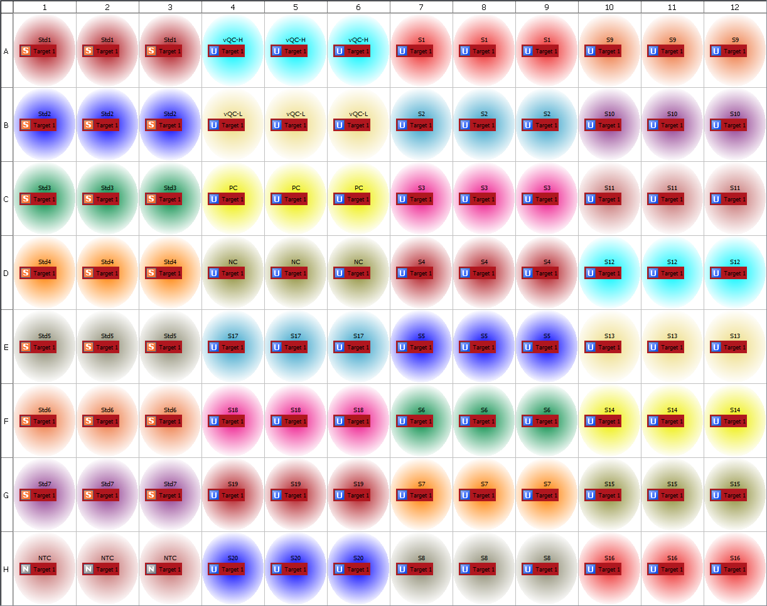
Plate Layout
2018-06-19 2377-009 TPP1 qPCR Run 4

Slide 3
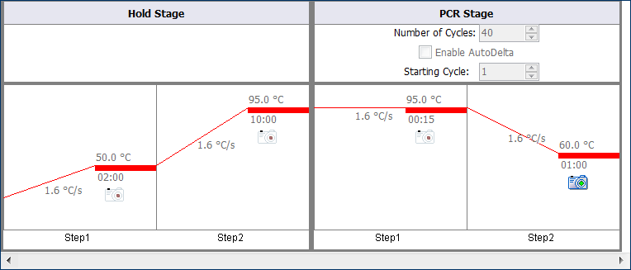
Thermal Method
2018-06-19 2377-009 TPP1 qPCR Run 4

Slide 4
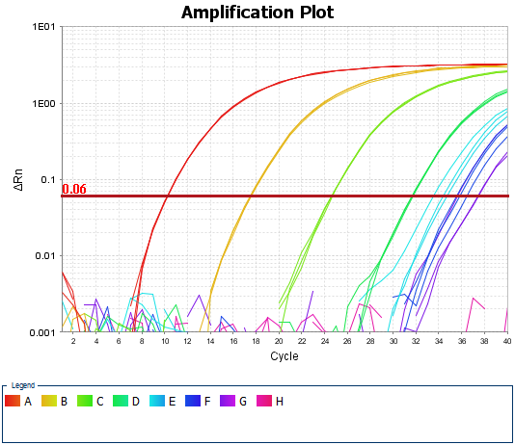
Amplification Plot
2018-06-19 2377-009 TPP1 qPCR Run 4

Slide 5
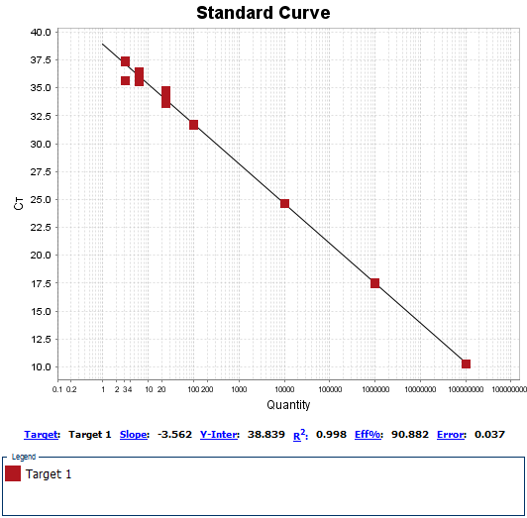
Standard Curves
2018-06-19 2377-009 TPP1 qPCR Run 4

